Slide 1

Reliance Industries Stock Forecast
Data Science Project-277 Group: 01
Mentor: Neha Ramchandani
2023-August
Team Members:
Mr. Pushkar Manohar Chaudhari
Mr. Ramavat Sri Krishna
Mr. Aishwarya Pradhan
Mr. Danthuluri Satya Narasimha Raju
Mr. Sanket Purushottamappa Karane

Slide 2
Business Problem:
Stock Forecast
Objective:
Predict the Reliance Industries Stock Price for the next 30 days.
There are Open, High, Low and Close prices that you need to obtain from the web for day starting from 2000 to 2022 for Reliance Industries stock.
Split the last year into a test set- to build a model to predict stock price.
Find short term, & long term trends.
Understand how it is impacted from external factors or any big external events.
Forecast for next 1 year.
.

Slide 3
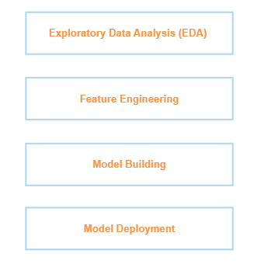
Project Architecture / Project Flow

Slide 4
Data Set Details
https://finance.yahoo.com/quote/RELIANCE.NS/history?p=RELIANCE.NS&guccounter=1
Date | Open | High | Low | Close | Adj Close | Volume
03-01-2000 | 36.74746 | 38.94457 | 36.74746 | 38.94457 | 29.6842 | 28802010
04-01-2000 | 39.98124 | 42.0623 | 38.88268 | 42.0623 | 32.06059 | 61320457
05-01-2000 | 39.71046 | 44.54566 | 39.71046 | 43.71014 | 33.31658 | 173426953
06-01-2000 | 44.71586 | 46.52615 | 44.71586 | 45.54364 | 34.71412 | 101355113
07-01-2000 | 45.64421 | 49.18744 | 45.33476 | 48.66911 | 37.09641 | 128426756
10-01-2000 | 49.11008 | 49.31122 | 47.23789 | 47.73301 | 36.3829 | 86714866
11-01-2000 | 47.64792 | 48.1121 | 43.91902 | 44.63849 | 34.02419 | 81074352
12-01-2000 | 44.71586 | 47.19148 | 43.65598 | 46.68088 | 35.58094 | 78264129
13-01-2000 | 47.3462 | 48.95535 | 47.05222 | 48.25135 | 36.77798 | 110363002
14-01-2000 | 47.88774 | 49.76767 | 47.88774 | 48.93988 | 37.30279 | 86996234
17-01-2000 | 49.2416 | 49.96107 | 47.50866 | 47.7717 | 36.41239 | 69343031
18-01-2000 | 47.81038 | 49.3499 | 47.27657 | 48.61496 | 37.05512 | 65168824
Notes:
a

Slide 5
Exploratory Data Analysis (EDA)

Slide 6

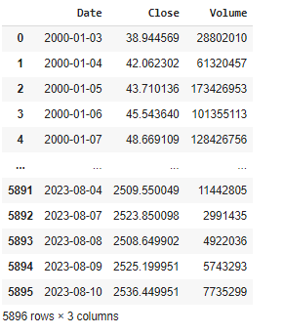
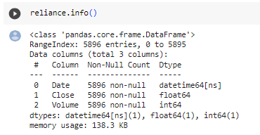
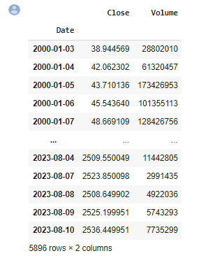

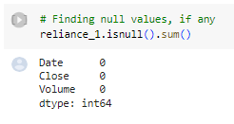
Exploratory Data Analysis (EDA)
Analysis is only based on Close price and Volume

Slide 7
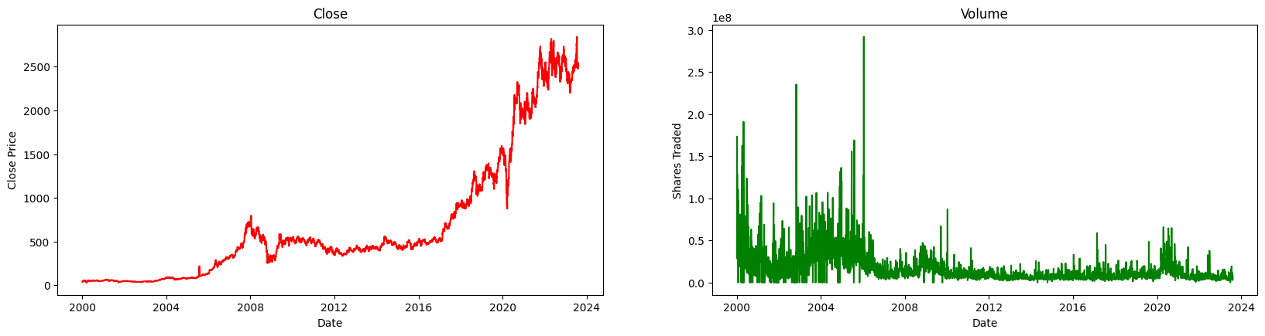
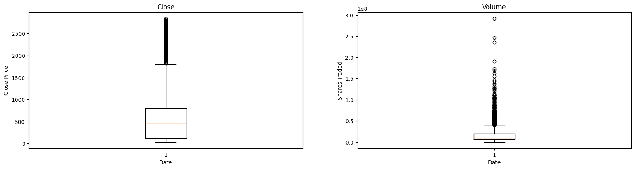
Exploratory Data Analysis (EDA)
Visualization
Box Plots

Slide 8
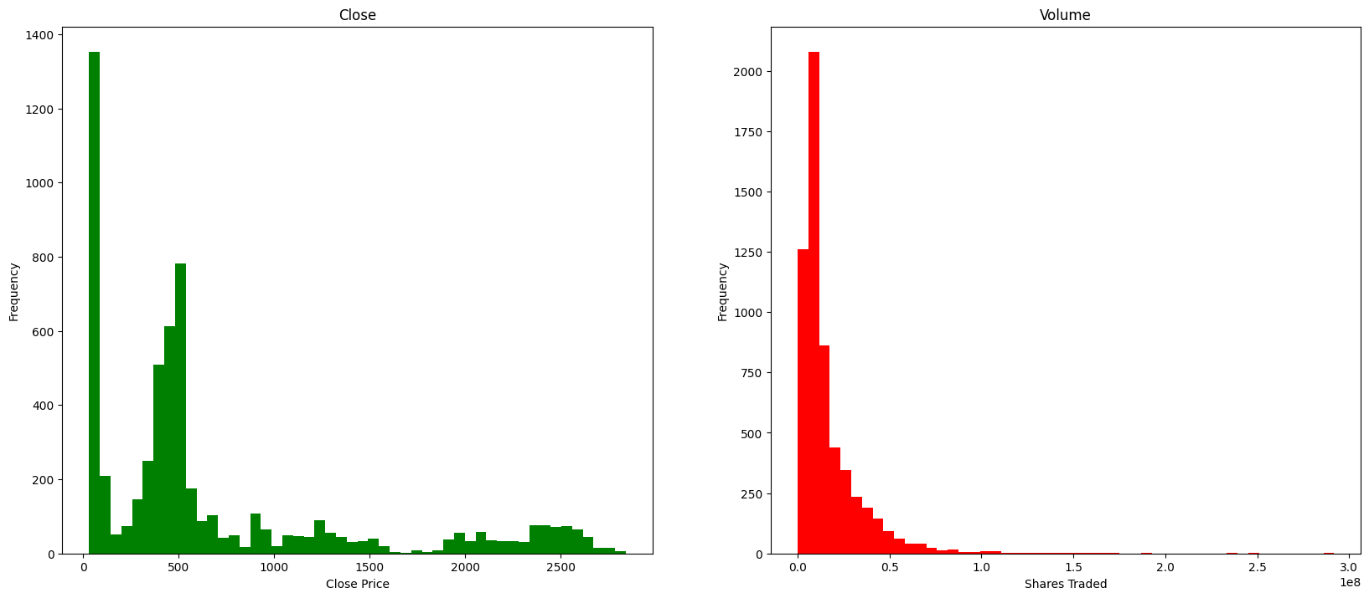
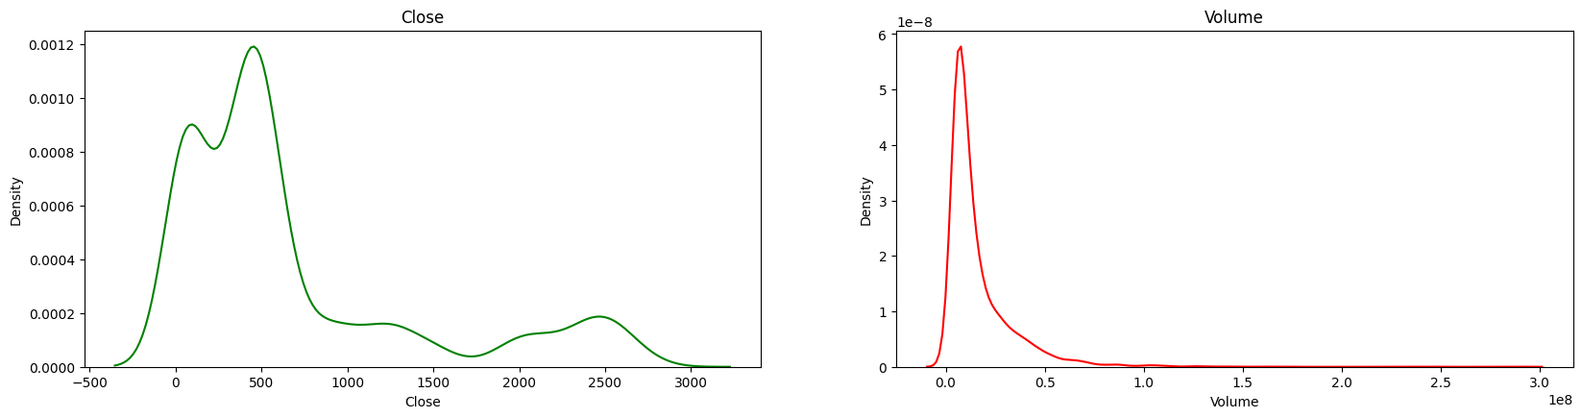
Exploratory Data Analysis (EDA)
Histogram
KDE-Plots

Slide 9
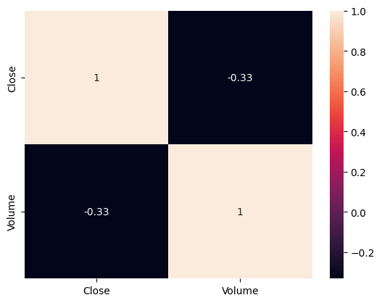
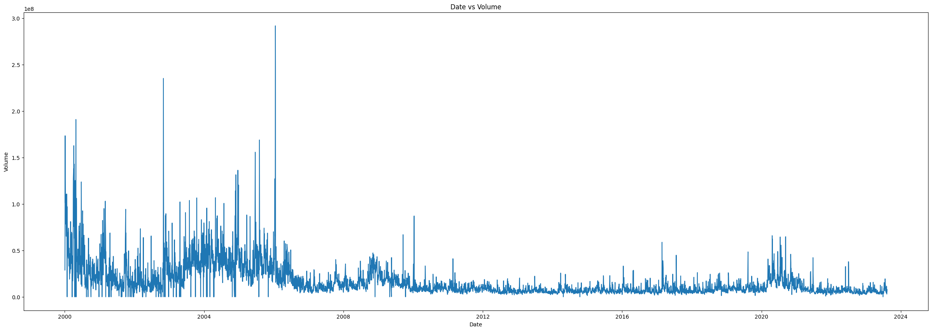
Exploratory Data Analysis (EDA)
Heat Map For Correlation analysis
Close attribute is highly corelated.
Date Vs Volume Trend

Slide 10
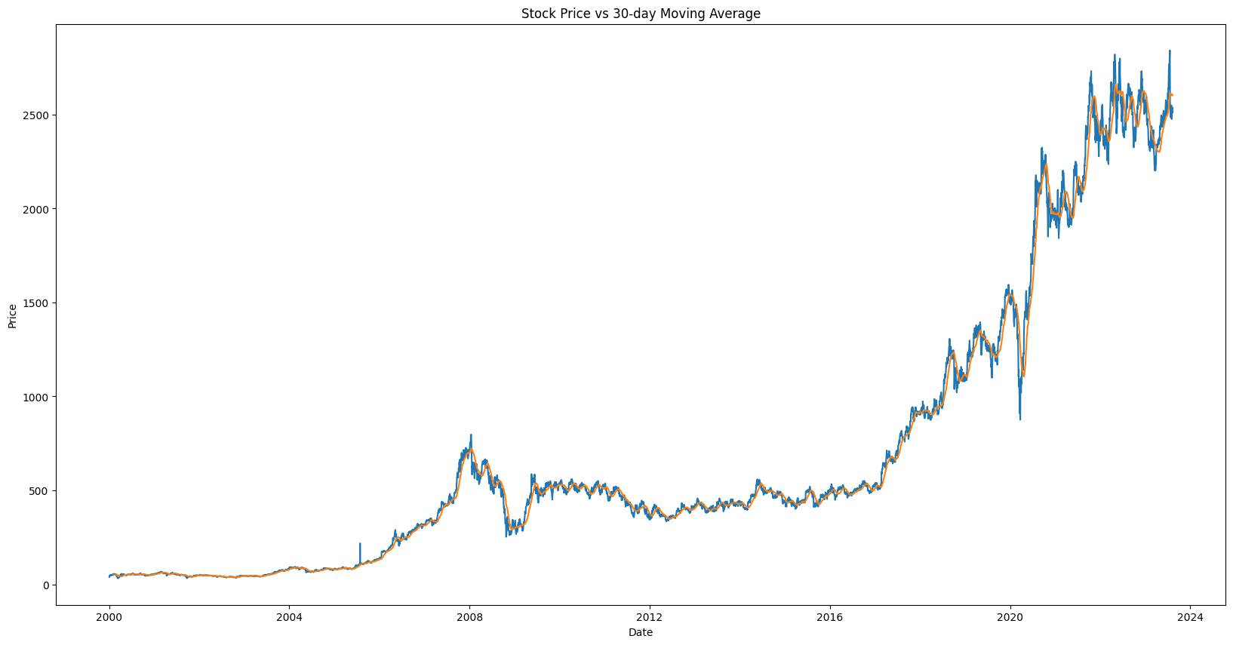
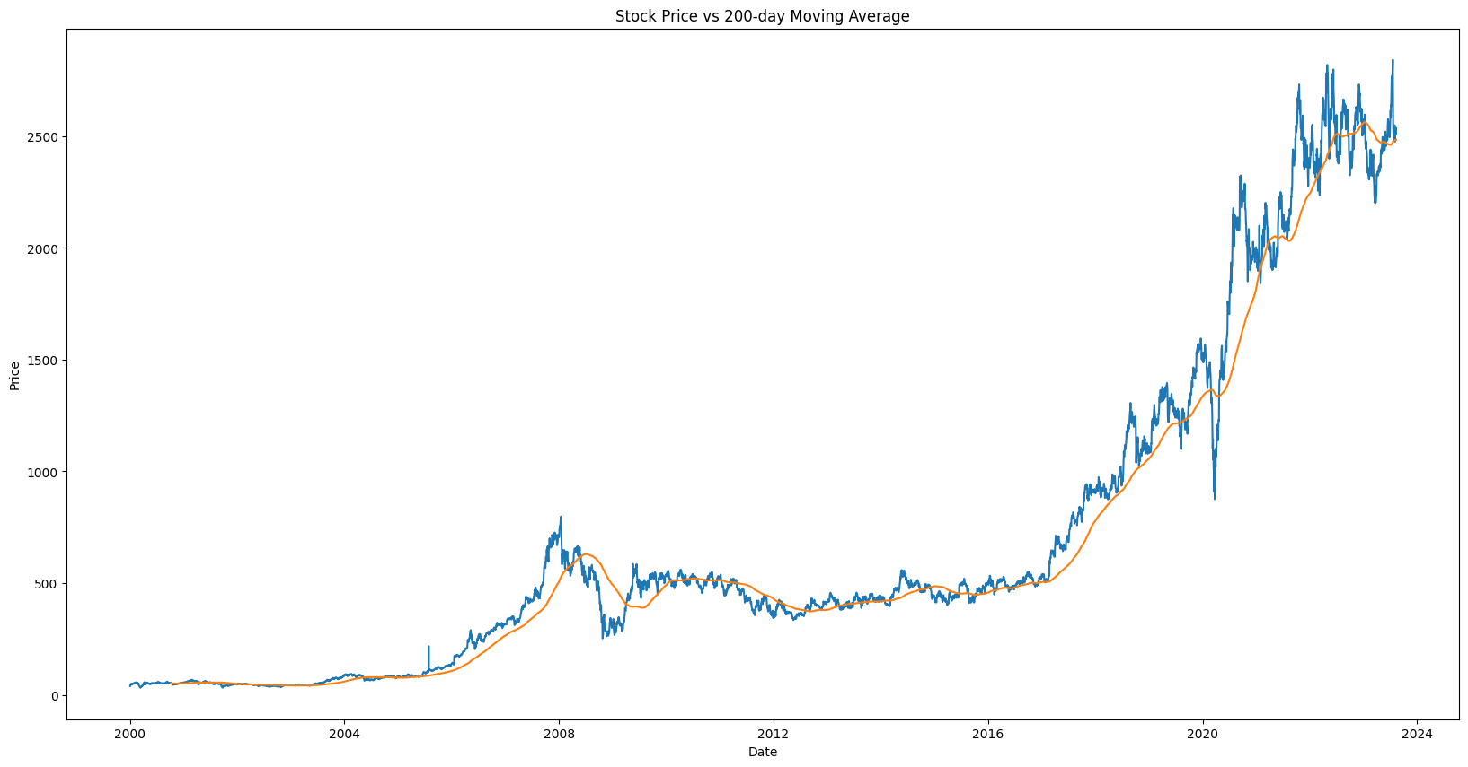
Exploratory Data Analysis (EDA)
Stock Price Vs 30 days Moving Average
Stock Price Vs 200 days Moving Average

Slide 11
Model Building

Slide 12
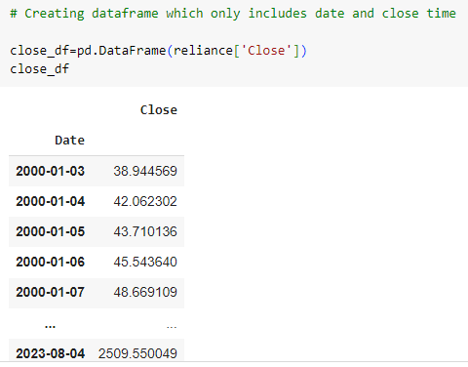
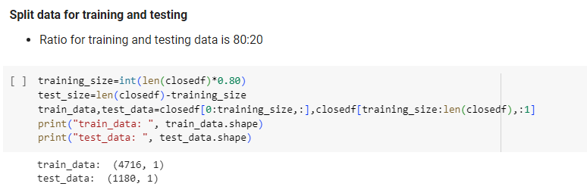
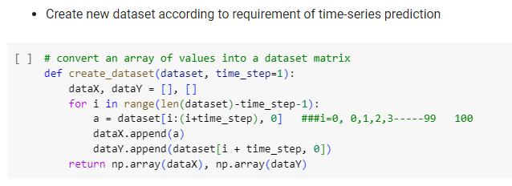
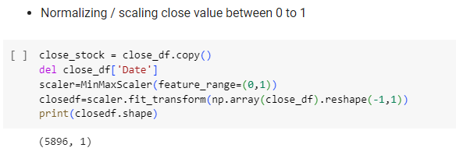
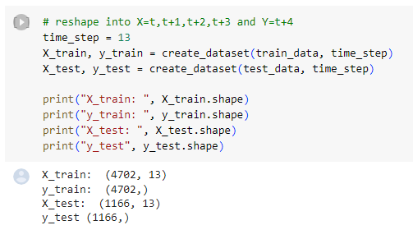
Model Building

Slide 13
Model Building and Evaluation
Algorithms For Model Evaluation
Support vector regression – SVR
It's based on the principles of Support Vector Machines (SVM), which are primarily designed for classification tasks.
SVR extends SVM to handle regression problems, where the goal is to predict a continuous output value rather than assigning classes.
SVR works by finding a regression function that minimizes the deviation between the predicted values and the actual target values while still staying within a certain tolerance margin.
The key idea is to find a balance between fitting the data closely and preventing overfitting.
2. Random Forest Regressor – RF
machine learning algorithm that belongs to the family of ensemble methods. It's used for regression tasks, where the goal is to predict a continuous numeric value as the output.
Random Forest is an extension of decision tree algorithms that combines the predictions of multiple individual decision trees to improve accuracy and robustness.
3. K-nearest neighgbour – KNN
simple and intuitive machine learning algorithm used for both classification and regression tasks.
It's a type of instance-based or lazy learning algorithm, meaning that it doesn't build an explicit model during the training phase.
Instead, it memorizes the training data and uses it to make predictions on new, unseen data points.
4. LSTM (Long Short-Term Memory)
recurrent neural network (RNN) architecture that is designed to capture long-term dependencies and patterns in sequential data.
effective in handling sequences where elements have time dependencies or other temporal relationships, such as natural language processing tasks, speech recognition, time series analysis, and more.
5. GRU (Gated Recurrent Unit)
recurrent neural network (RNN) architecture
GRUs were designed to capture long-range dependencies in sequential data while addressing some of the shortcomings of LSTM, with a simplified architecture and fewer parameters.
GRUs belong to the family of gated RNNs, which means they incorporate gating mechanisms to control the flow of information and manage the vanishing gradient problem that affects training in traditional RNNs.

Slide 14
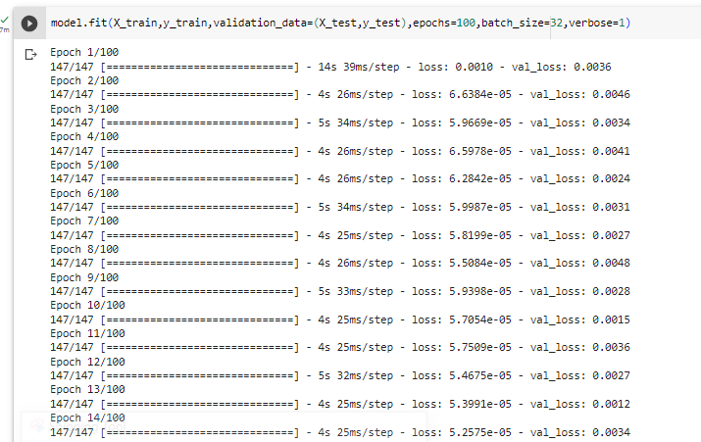
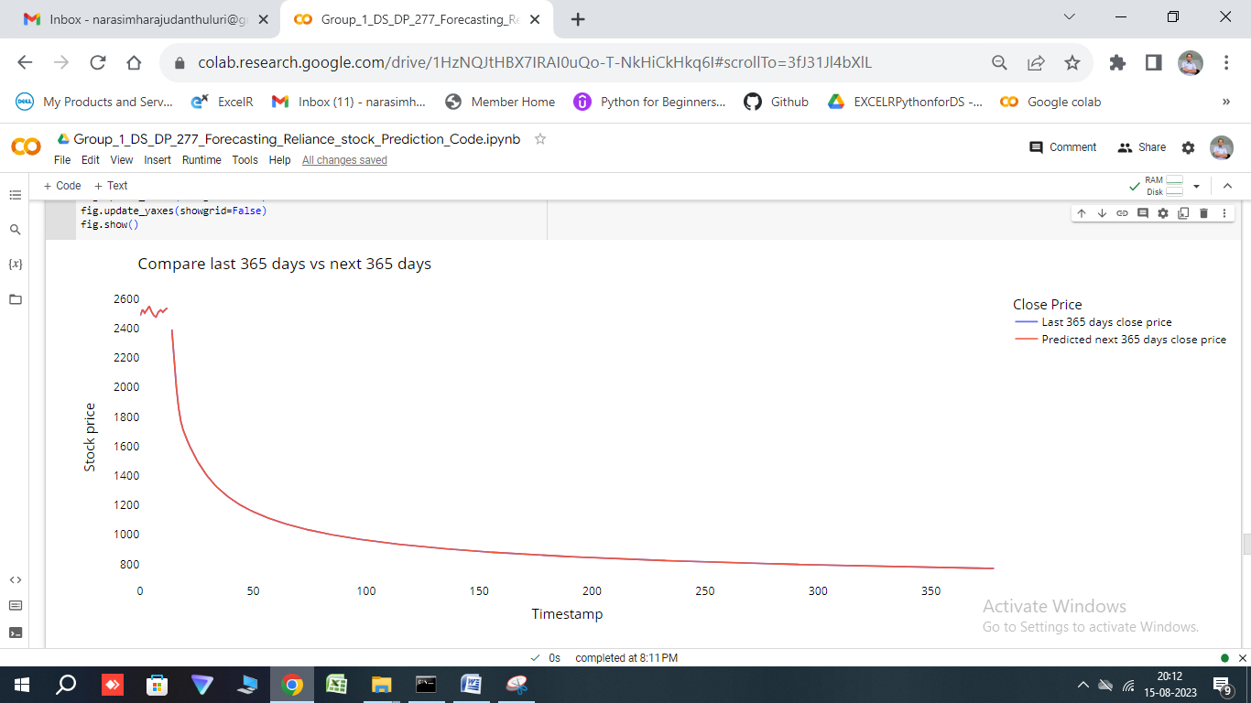
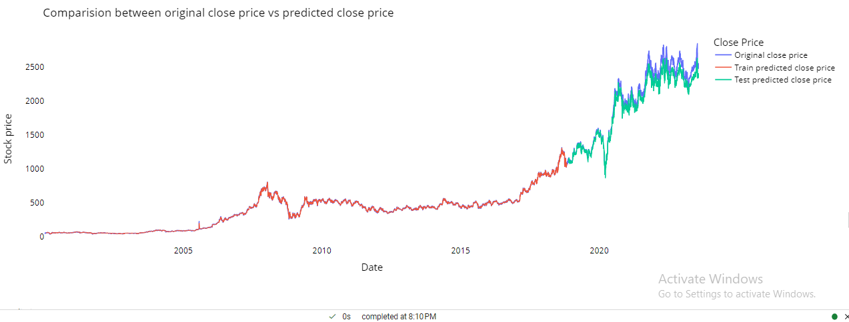
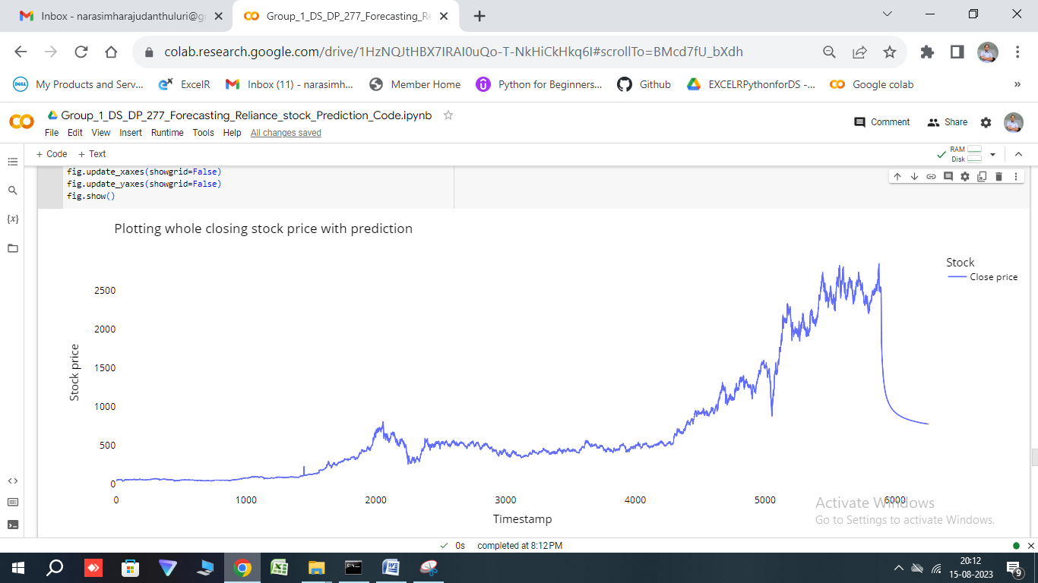
Insights From the Model Building and Evaluation
The Various scores obtained from the model evaluation are:
 | Model | Train R2 Score | Test R2 Score
0 | SVR | 0.530762 | -0.232480
1 | Random Forest | 0.999795 | -2.055486
2 | KNN | 0.998035 | -2.128971
3 | LSTM | 0.998789 | 0.956558
4 | GRU | 0.998584 | 0.922577
By Looking into this table we can say that our LSTM model have best R2 score.
so we are going to use LSTM model for our deployment part.

Slide 15
Model Deployment using streamlit library
using Platform- Spyder

Slide 16
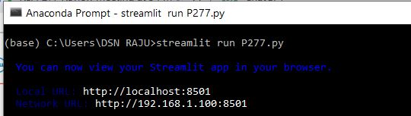
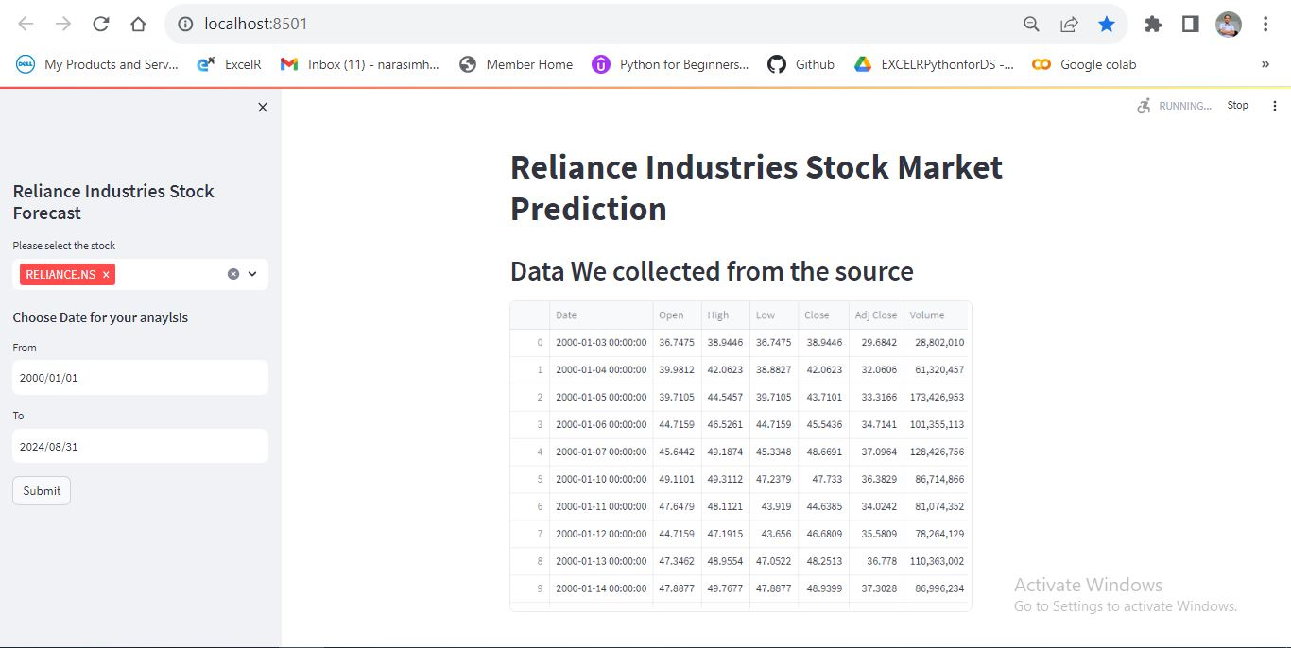
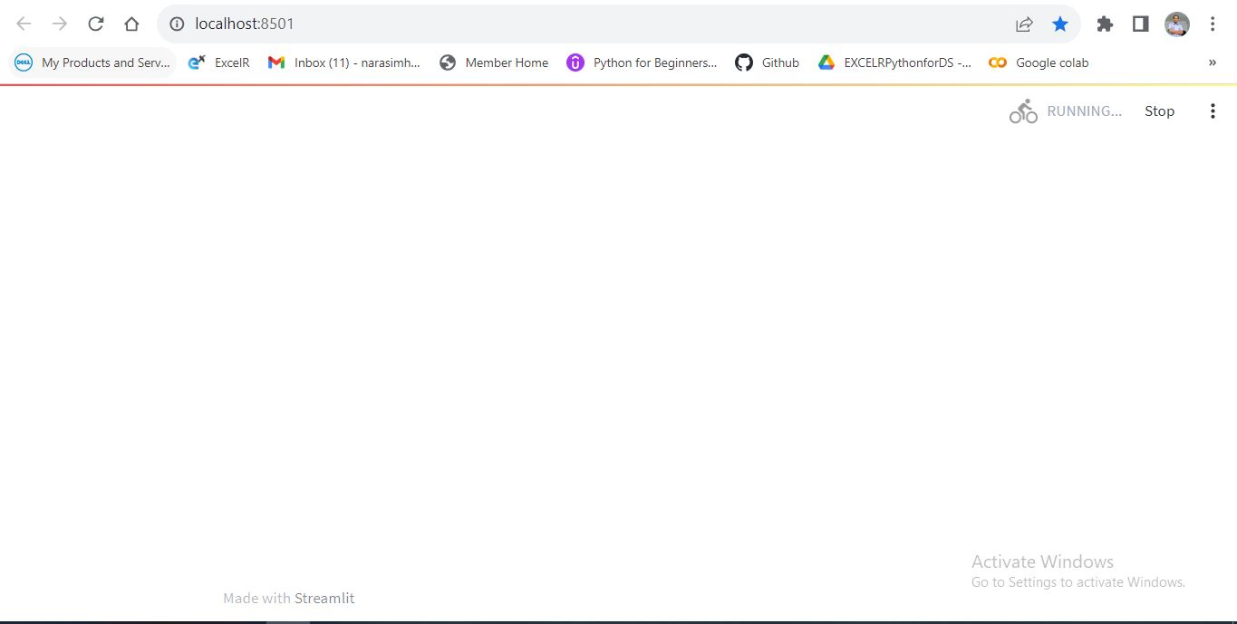
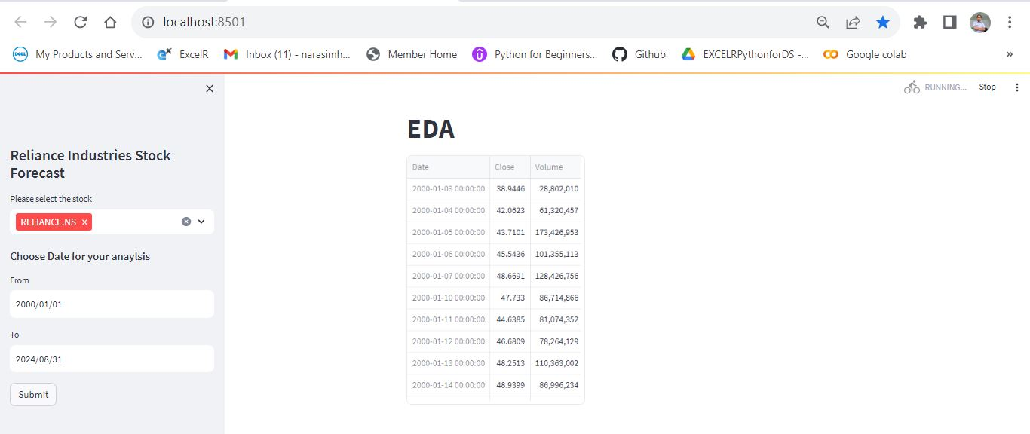
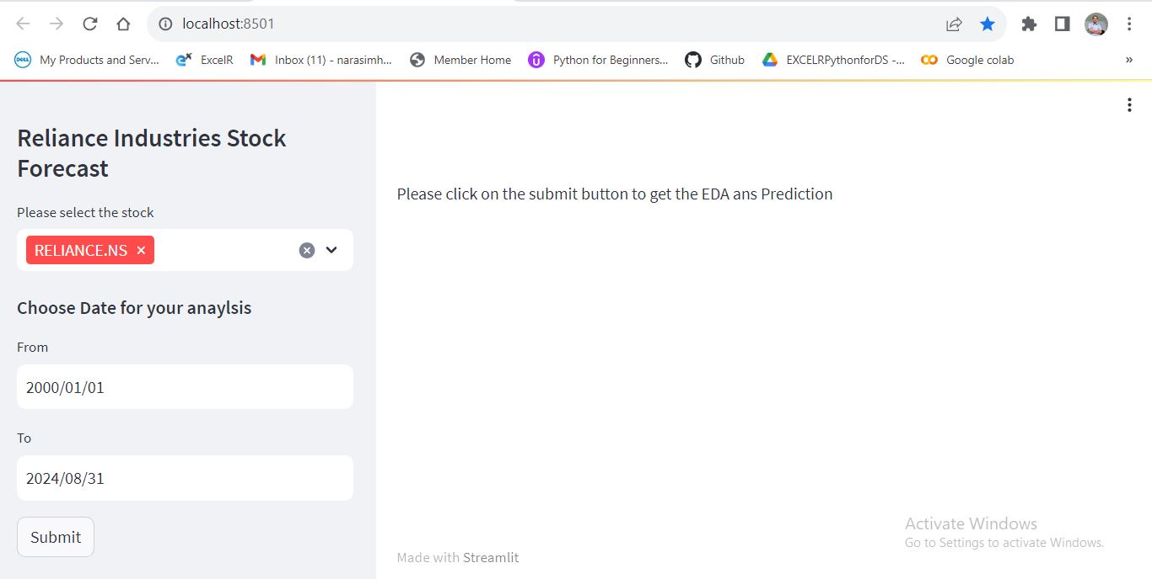
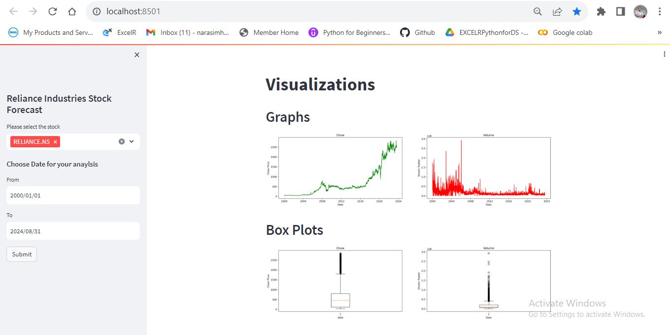

Slide 17
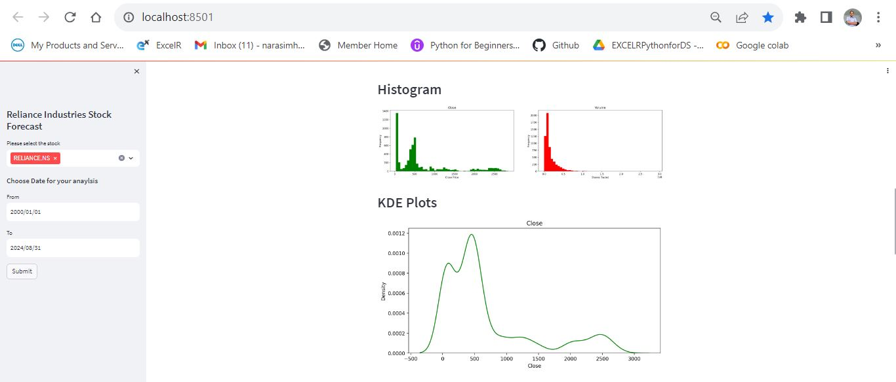
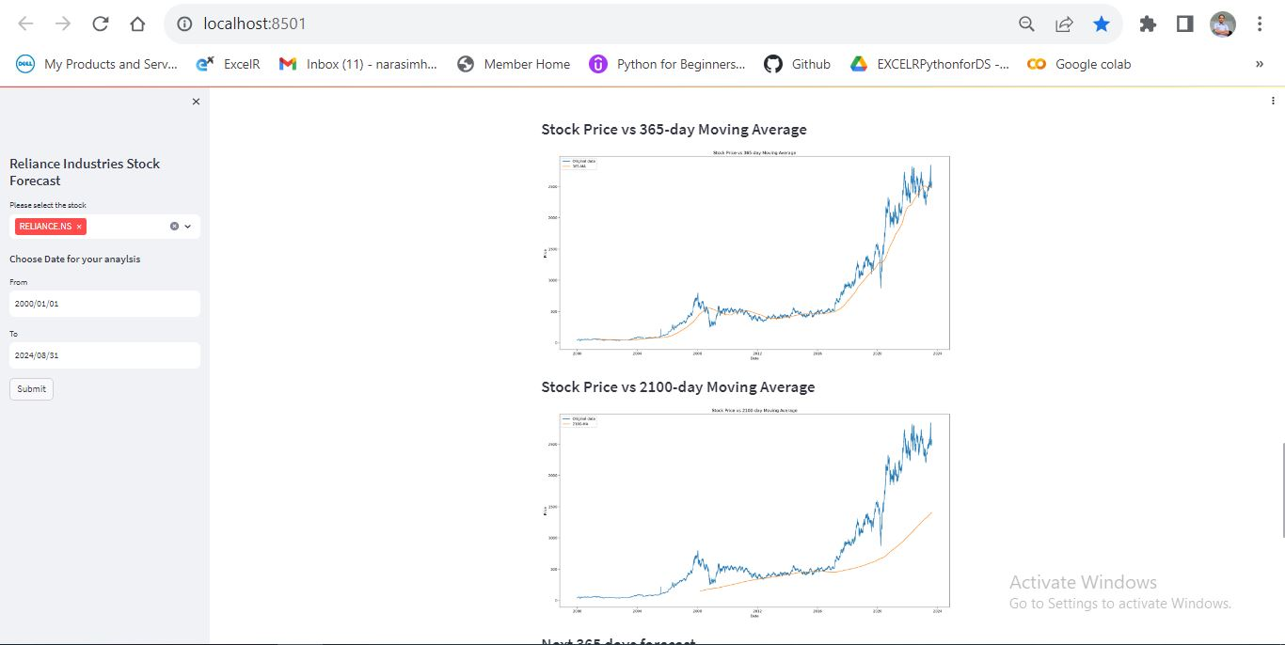
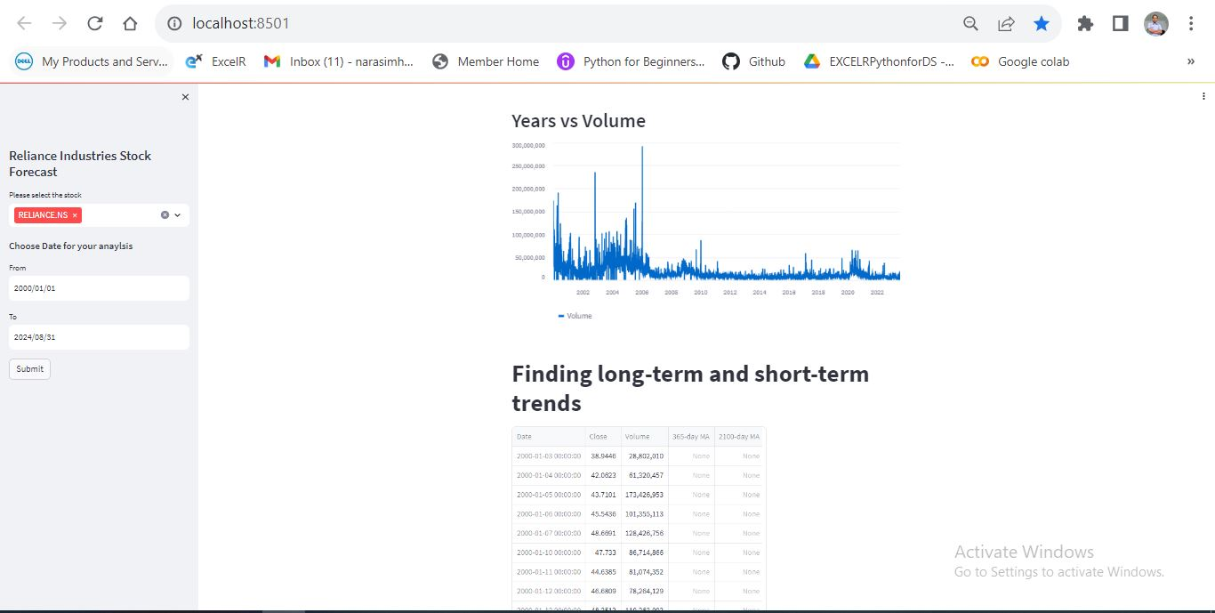
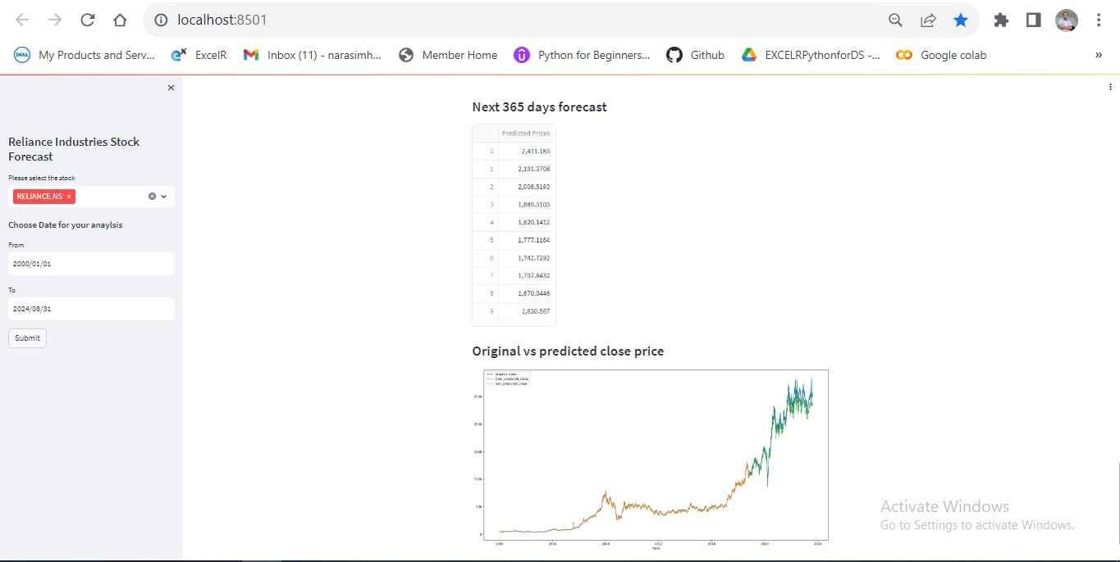

Slide 18
Challenges faced?
The deployment part has given a slight difficulty in the understanding part .
A precise answer was never sought to us.
How did you overcome?
All the members approached our respective teachers.
We retrieved necessary inputs from our friends.
Various platforms were used .
Finally we achieved the deployment part for forecasting.

Slide 19
Files submitted for the Project
Group 1_P-277_ Reliance Industries Stock Forecast.ppt file
Group_1_DS_DP_277_Forecasting_Reliance_stock_Prediction_Final__Code.ipynb file
P277.py (Deployment code)
model_building.py (support for P277.py)
setup.py (support for P277.py)
P277_Group1_Deployment Presentation Video

Slide 20
Thank you

